Slide 1
Joining for Further Insight

Slide 2

Overview
Combining records and data from multiple tables
Joining is what makes a database “relational”
Three types of joins

Slide 3



Data Keys
Keys are fields that describe relationships between tables
Primary key uniquely identifies each record in the table
Foreign key in a table refers to a primary key (data) in another table

Slide 4


Relationships
 | customer_id |  | first_name | last_name | city | state
 | 121 |  | John | Smith | Tuscaloosa | Alabama
 | 122 |  | Jane | Doe | Meridian | Mississippi
 | 123 |  | Bob | Clark | Santa Fe | New Mexico
 | 124 |  | Estella | Dodd | Tulsa | Oklahoma
 | 125 |  | Clair | Fletcher | Portland | Oregon
Customers
order_id |  | order_date | order_amt | shipped | customer_id
9001 |  | 10/19/2018 | 385.95 | Yes | 124
9002 |  | 10/22/2018 | 1922.40 | Backorder | 125
9003 |  | 10/14/2018 | 320.55 | Yes | 124
9004 |  | 10/15/2018 | 12.40 | Yes | 122
9005 |  | 10/02/2018 | 1350.22 | Backorder | 123
Orders

Slide 5
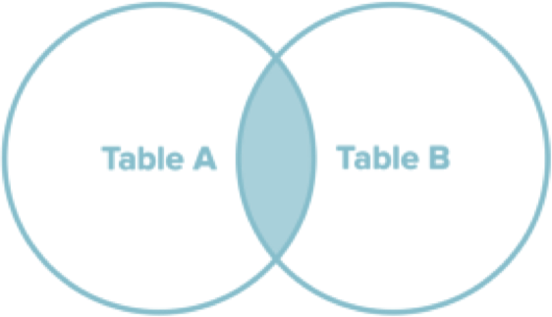
Inner Join
Returns all rows from two or more tables that meet the join condition
Joined fields must exist in both tables

Slide 6
SELECT customers.*,
orders.* FROM customers
INNER JOIN orders
ON customers.customer_id = orders.customer_id;
Inner Join
Specify source table for each field
INNER JOIN keyword specifies type of join ON specifies fields to join

Slide 7
Inner Join Results
customer_id | first_name | last_name | city | state
121 | John | Smith | Tuscaloosa | Alabama
122 | Jane | Doe | Meridian | Mississippi
123 | Bob | Clark | Santa Fe | New Mexico
124 | Estella | Dodd | Tulsa | Oklahoma
125 | Clair | Fletcher | Portland | Oregon
order_id | order_date | order_amt | shipped | customer_id
9001 | 10/19/2018 | 385.95 | Yes | 124
9002 | 10/22/2018 | 1922.40 | Backorder | 125
9003 | 10/14/2018 | 320.55 | Yes | 124
9004 | 10/15/2018 | 12.40 | Yes | 122
9005 | 10/02/2018 | 1350.22 | Backorder | 123
customer_id | first_name | last_name | city | state | order_id | order_date | order_amt | shipped | customer_id
122 | Jane | Doe | Meridian | Mississippi | 9004 | 10/15/2018 | 12.40 | Yes | 122
123 | Bob | Clark | Santa Fe | New Mexico | 9005 | 10/02/2018 | 1350.22 | Backorder | 123
124 | Estela | Dodd | Tulsa | Oklahoma | 9001 | 10/19/2018 | 385.95 | Yes | 124
124 | Estella | Dodd | Tulsa | Oklahoma | 9003 | 10/14/2018 | 320.55 | Yes | 124
125 | Clair | Fletcher | Portland | Oregon | 9002 | 10/22/2018 | 1922.40 | Backorder | 125

Slide 8
SELECT customers.first_name,
customers.last_name, orders.order_date, orders.order_amount
FROM customers INNER JOIN orders
ON customers.customer_id = orders.customer_id;
first_name | last_name | order_date | order_amt
Jane | Doe | 10/15/2018 | 12.40
Bob | Clark | 10/02/2018 | 1350.22
Estela | Dodd | 10/19/2018 | 385.95
Estella | Dodd | 10/14/2018 | 320.55
Clair | Fletcher | 10/22/2018 | 1922.40

Slide 9
SELECT customers.first_name,
customers.last_name, orders.order_date, orders.order_amount
FROM customers INNER JOIN orders
ON customers.customer_id = orders.customer_id WHERE customers.last_name = ‘Dodd’
first_name | last_name | order_date | order_amt
Estela | Dodd | 10/19/2018 | 385.95
Estella | Dodd | 10/14/2018 | 320.55

Slide 10


Alternative Inner Join Syntax
FROM customers INNER JOIN orders
ON customers.customer_id = orders.customer_id
FROM customers JOIN orders
ON customers.customer_id = orders.customer_id
FROM customers, orders
WHERE customers.customer_id = orders.customer_id

Slide 11
Alias
Temporary label in a query

Slide 12
SELECT c.first_name,
c.last_name, o.order_date, o.order_amount
FROM customers AS c
FROM customers c
INNER JOIN orders o
INNER JOIN orders AS o
ON c.customer_id = o.customer_id
WHERE c.last_name = ‘Dodd’
first_name | last_name | order_date | order_amt
Estela | Dodd | 10/19/2018 | 385.95
Estella | Dodd | 10/14/2018 | 320.55

Slide 13
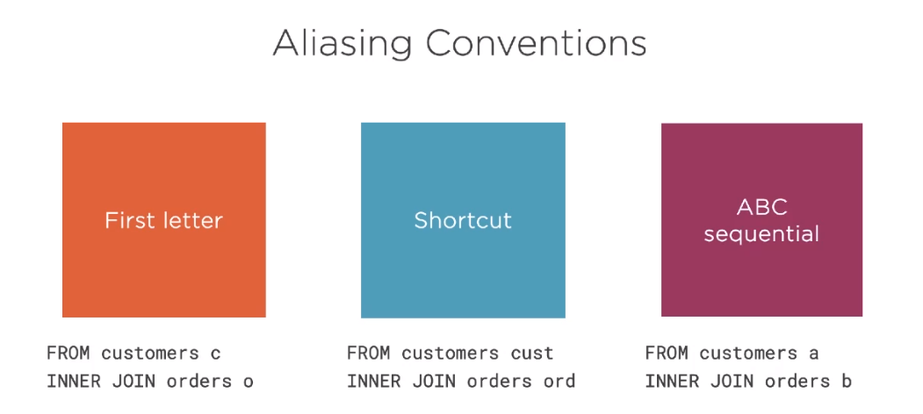

Slide 14
Consistency will make your code more easily readable

Slide 15
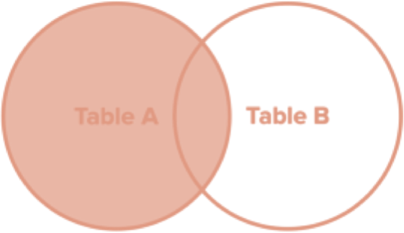
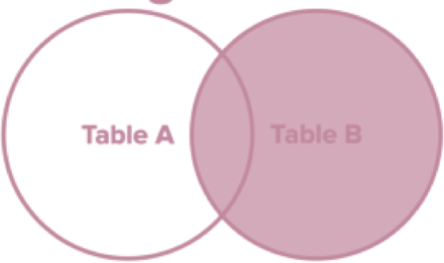
Outer Joins
Left Join
Right Join
Returns all records from the left table along with any matching records from the right table
Returns all records from the right table along with any matching records from the left table

Slide 16
SELECT c.first_name,
c.last_name, o.order_date, o.order_amount
FROM customers c LEFT OUTER JOIN orders o
ON c.customer_id = o.customer_id
Left Outer Join
LEFT OUTER JOIN keyword specifies type of join
ON specifies fields to join

Slide 17
Left Join Results
customer_id | first_name | last_name | city | state
121 | John | Smith | Tuscaloosa | Alabama
122 | Jane | Doe | Meridian | Mississippi
123 | Bob | Clark | Santa Fe | New Mexico
124 | Estella | Dodd | Tulsa | Oklahoma
125 | Clair | Fletcher | Portland | Oregon
order_id | order_date | order_amt | shipped | customer_id
9001 | 10/19/2018 | 385.95 | Yes | 124
9002 | 10/22/2018 | 1922.40 | Backorder | 125
9003 | 10/14/2018 | 320.55 | Yes | 124
9004 | 10/15/2018 | 12.40 | Yes | 122
9005 | 10/02/2018 | 1350.22 | Backorder | 123
 | first_name | last_name | order_date | order_amt
 | John | Smith | [null] | [null]
 | Jane | Doe | 10/15/2018 | 12.40
 | Bob | Clark | 10/02/2018 | 1350.22
 | Estela | Dodd | 10/19/2018 | 385.95
 | Estella | Dodd | 10/14/2018 | 320.55
 | Clair | Fletcher | 10/22/2018 | 1922.40

Slide 18
SELECT c.first_name,
c.last_name, o.order_date, o.order_amount
FROM customers c RIGHT OUTER JOIN orders o
ON c.customer_id = o.customer_id
Right Outer Join
RIGHT OUTER JOIN keyword specifies type of join
ON specifies fields to join

Slide 19
Right Join Results
customer_id | first_name | last_name | city | state
121 | John | Smith | Tuscaloosa | Alabama
122 | Jane | Doe | Meridian | Mississippi
123 | Bob | Clark | Santa Fe | New Mexico
124 | Estella | Dodd | Tulsa | Oklahoma
125 | Clair | Fletcher | Portland | Oregon
order_id | order_date | order_amt | shipped | customer_id
9001 | 10/19/2018 | 385.95 | Yes | 124
9002 | 10/22/2018 | 1922.40 | Backorder | 125
9003 | 10/14/2018 | 320.55 | Yes | 124
9004 | 10/15/2018 | 12.40 | Yes | 122
9005 | 10/02/2018 | 1350.22 | Backorder | 123
9006 | 10/24/2018 | 920.40 | Yes
 | first_name | last_name | order_date | order_amt
 | [null] | [null] | 10/24/2018 | 920.40
 | Jane | Doe | 10/15/2018 | 12.40
 | Bob | Clark | 10/02/2018 | 1350.22
 | Estela | Dodd | 10/19/2018 | 385.95
 | Estella | Dodd | 10/14/2018 | 320.55
 | Clair | Fletcher | 10/22/2018 | 1922.40

Slide 20
Outer Join Syntax
LEFT OUTER JOIN
LEFT JOIN

Slide 21
SELECT c.first_name,
c.last_name, o.order_date, o.order_amount
FROM customers c
FROM orders o
LEFT JOIN customers c
RIGHT JOIN orders o
ON c.customer_id = o.customer_id
Left vs. Right Joins
Left outer joins are far more prevalent in practice
Can be easier to read and interpret

Slide 22
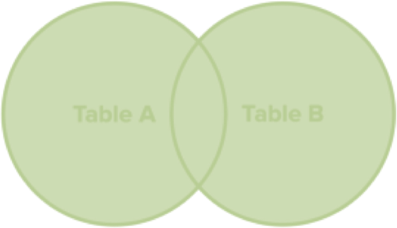
Full Join
Returns all rows from two or more tables regardless of whether the join condition is met
If no match, the missing side will contain null

Slide 23
SELECT c.first_name,
c.last_name, o.order_date, o.order_amount
FROM customers c FULL OUTER JOIN orders o
ON c.customer_id = o.customer_id
Full Outer Join
FULL OUTER JOIN keyword specifies type of join
ON specifies fields to join

Slide 24
Full Join Results
customer_id | first_name | last_name | city | state
121 | John | Smith | Tuscaloosa | Alabama
122 | Jane | Doe | Meridian | Mississippi
123 | Bob | Clark | Santa Fe | New Mexico
124 | Estella | Dodd | Tulsa | Oklahoma
125 | Clair | Fletcher | Portland | Oregon
order_id | order_date | order_amt | shipped | customer_id
9001 | 10/19/2018 | 385.95 | Yes | 124
9002 | 10/22/2018 | 1922.40 | Backorder | 125
9003 | 10/14/2018 | 320.55 | Yes | 124
9004 | 10/15/2018 | 12.40 | Yes | 122
9005 | 10/02/2018 | 1350.22 | Backorder | 123
9006 | 10/24/2018 | 920.40 | Yes
first_name | last_name | order_date | order_amt
[null] | [null] | 10/24/2018 | 920.40
Jane | Doe | 10/15/2018 | 12.40
Bob | Clark | 10/02/2018 | 1350.22
Estela | Dodd | 10/19/2018 | 385.95
Estella | Dodd | 10/14/2018 | 320.55
Clair | Fletcher | 10/22/2018 | 1922.40
John | Smith | [null] | [null]

Slide 25
Lookup tables
Database tables that contain data that specify the values for given codes

Slide 26

Demo
Implementing joins
Employing lookup tables

Slide 27


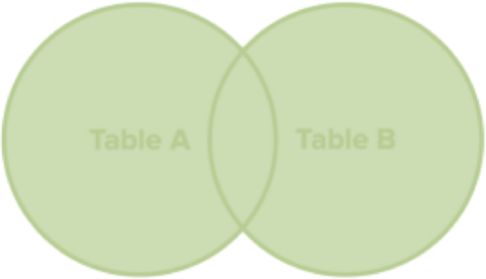
Inner join
Summary
Left outer join
Right outer join
Full
outer join

